Slide 1




Програм мобилности за студенте
KA131-mobilnost u okviru EU

Slide 2

Erasmus+ Mobility Program
Erasmus+ European Mobility is a program that enables student and staff mobility between higher education institutions (HEIs) of:
27 EU member countries
and the following third countries associated to the programme:
Norway, Iceland, Liechtenstein, Republic of North Macedonia, Republic of Turkey and Republic of Serbia;
The EU Member States and the above mentioned third countries associated to the programme will be hereafter called “EU Member States and third countries associated to the Program”.
International cooperation between HEIs in these countries is established through bilateral inter-institutional agreements of cooperation.
.

Slide 3
Potrebna dokumentacija
[01] Confirmation of enrollment
Potvrda o upisanoj godini – potvrda ste upisali tekuću školsku godinu u okviru studijskog programa na koji ste upisani). Dokument ne mora biti preveden na engleski jezik.
* [02] Copy of the first page of your student booklet
Skenirana prva strana indeksa na kojoj se nalaze podaci u vezi sa nazivom studijskog programa koji ste upisali, kao i koje ste školske godine prvi put upisali prvu godinu studija. Dokument ne mora biti preveden na engleski jezik.
* [03] Transcript of Records
Prepis ocena – izdat od strane matičnog Fakulteta na engleskom jeziku, ili preveden i overen od
strane sudskog tumača za engleski jezik.
[04] Diploma and diploma supplement of previously obtained degrees
Diploma/e i dodatak/ci diplome/a koje ste stekli na prethodnim nivoima studija.
Ukoliko smatrate da su ova dokumenta relevantna za Vašu prijavu i eventualnu selekciju
i da daju dodatno objašnjenje za odabir predmeta u okviru Vašeg Ugovora o učenju,
možete ih priložiti. Dokumenta ne moraju biti prevedena na engleski jezik.
.

Slide 4

Potrebna dokumentacija
* [05] Proof of language skills of relevant language at the host institution
Dokaz o stečenom nivou znanja stranog jezika koji je strana VŠI postavila kao uslov.
Obavezno proveriti šta se tačno traži
* [06] CV / Resume
Relevantna biografija na engleskom jeziku, ili zvaničnom jeziku strane VŠI domaćina.
[07] Motivational Letter
Motivaciono pismo na englesom jeziku ili zvaničnom jeziku strane VŠI domaćina.
[08] Erasmus+ Learning Agreement
Ugovor o učenju - Pre nego što počnete da pohađate nastavu iz izabranih predmeta na stranoj VŠI
domaćinu (receiving institution), potrebno je da imate zaključen Ugovor o učenju (Learning Agreement).
Ugovor o učenju je zaključen kada su ga potpisali: student, nadelžna osoba na matičnom fakultetu
(home institution) i nadležna osoba na stranoj VŠI domaćinu (receiving institution).

Slide 5

Erasmus+ Learning Agreement
Study Programme at the Receiving Institution Mobility type: Semester(s)
Table A | Component code (if any) | Component title at the Receiving Institution (as indicated in the course catalogue) | Semester [e.g. autumn/spring; term] | Number of ECTS credits (or equivalent) to be awarded by the Receiving Institution upon successful completion
 |  |  |  | Total: …
Web link to the course catalogue at the Receiving Institution describing the learning outcomes: [web link to the relevant information]

Slide 6

Erasmus+ traineeship – Praksa
Required documents for the application
Invitation letter from the receiving organization
(you can download the invitation letter template here, or the receiving
organization can provide their own)
Learning Agreement for Traineeship (which should be signed by the student and its home UB faculty at the time of application)
Transcript of Records, containing the information on enrollment
Relevant CV
Passport-sized photo
Learning Agreement and Invitation Letter must be in the English language! All other required documents can be in either English or Serbian.

Slide 7


Kratkoročne mobilnosti – studenti doktorskih studija
Studenti doktorskih studija imaju mogućnost da idu na kratkoročne fizičke mobilnosti u trajanju od minimalno 5 dana a maksimalno 30 dana.
Kratkoročne mobilnosti studenata doktorskih studija mogu se realizovati i kao trening mobilnosti
Nema obaveze ostvarivanja ESP bodoba
Više informacija: https://mobion.bg.ac.rs/erasmus+/erasmus-pages/ub-students-and-staff/outgoing-mobility-types-and-eligibility

Slide 8

Kratkoročne mobilnosti – Blended Intensive Program (BIP)
Studenti svih nivoa studija imaju mogućnost da idu na kratkoročne fizičke mobilnosti u trajanju od minimalno 5 dana a maksimalno 30 dana u okviru tzv. BIP programa.
Ove mobilnosti se obavljaju isključivo u svrhu (kratkoročnog) studiranja
Obvezna virtuelna komponenta, pored fizičkog dela mobilnosti
Minimum ESP bodova za realizovanu BIP mobilnost – 3 ESPB
Više informacija: https://mobion.bg.ac.rs/erasmus+/erasmus-pages/ub-students-and-staff/outgoing-mobility-types-and-eligibility

Slide 9

Monthly scholarships
KA131 (EU+6): Denmark, Finland, Iceland, Ireland, Luxembourg, Sweden, Liechtenstein, Norway, Austria, Belgium, Germany, France, Italy, Greece, Spain, Cyprus, Netherlands, Malta, Portugal United Kingdom, Andorra, Monaco, San Marino, Vatican City State, Faroe Islands, Switzerland | 600 EUR
KA131 (EU+6): Bulgaria, Croatia, Czech Republic, Estonia, Latvia, Lithuania, Hungary, Poland, Romania, Slovakia, North Macedonia, Slovenia, Turkey | 540 EUR
Student mobility for studies and traineeships: Participants with fewer opportunities
taking part in mobility are eligible for additional financial support of 250 EUR per month
(неразвијене општине и/или просечна плата)
Student mobility for traineeships: All students participating in student mobility for
traineeships are automatically eligible for a monthly top-up of 150 Euros to the basic
mobility grant. In case a student participating in traineeship mobility submits proof of
their eligibility for additional financial support of 250 EUR per month on the basis of
fewer opportunities, these two top-ups will be added and the student will receive
an additional 400 Euros to the basic monthly scholarship in this case

Slide 10
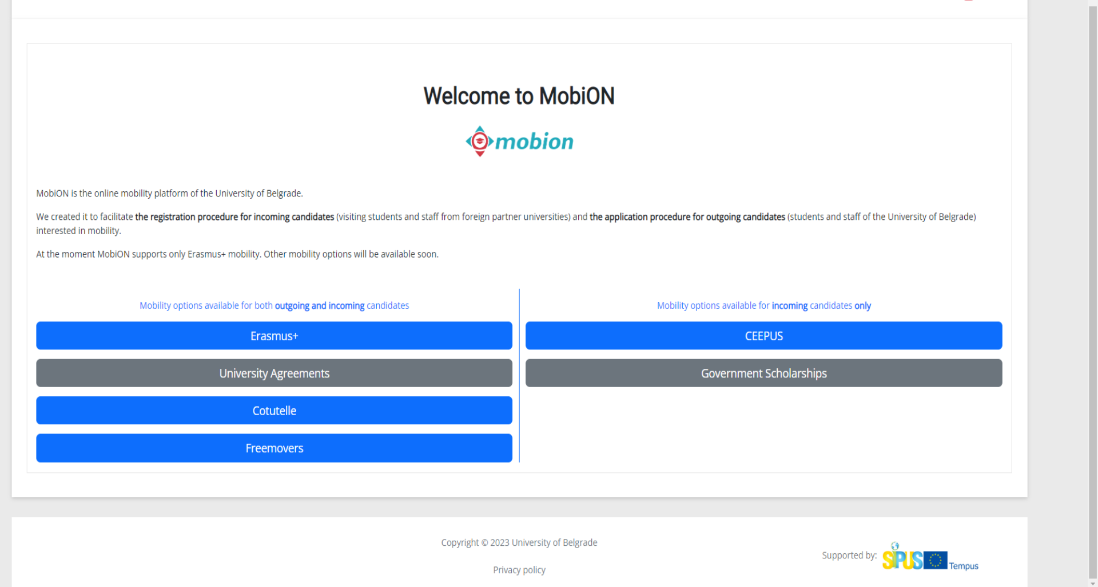

Slide 11
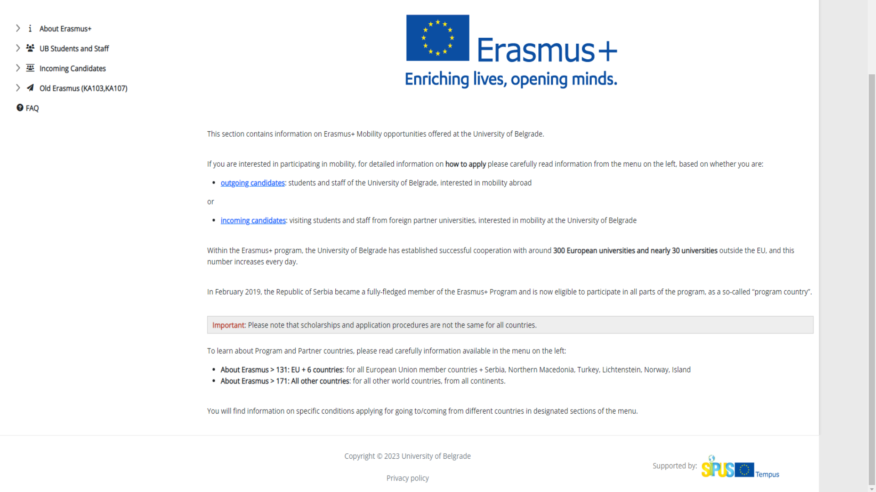

Slide 12
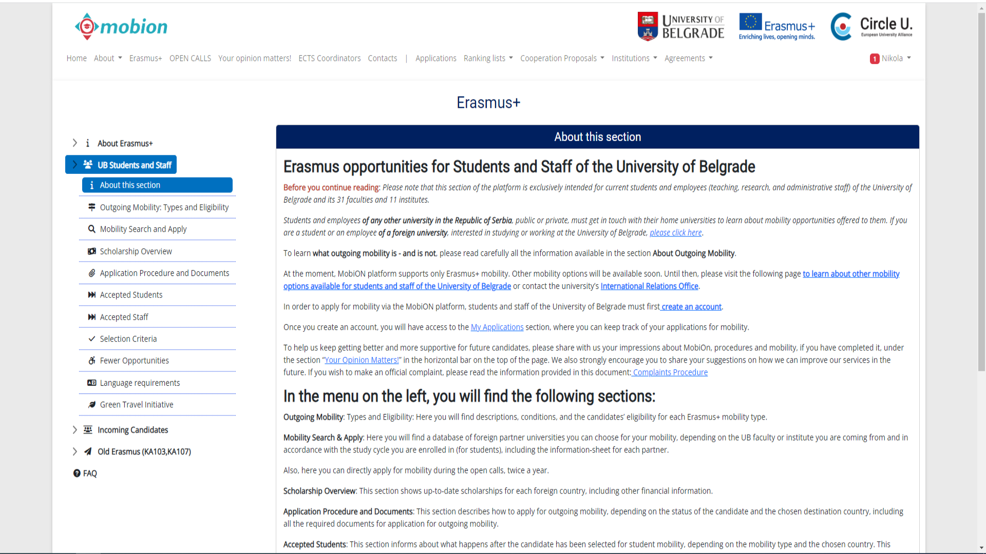

Slide 13
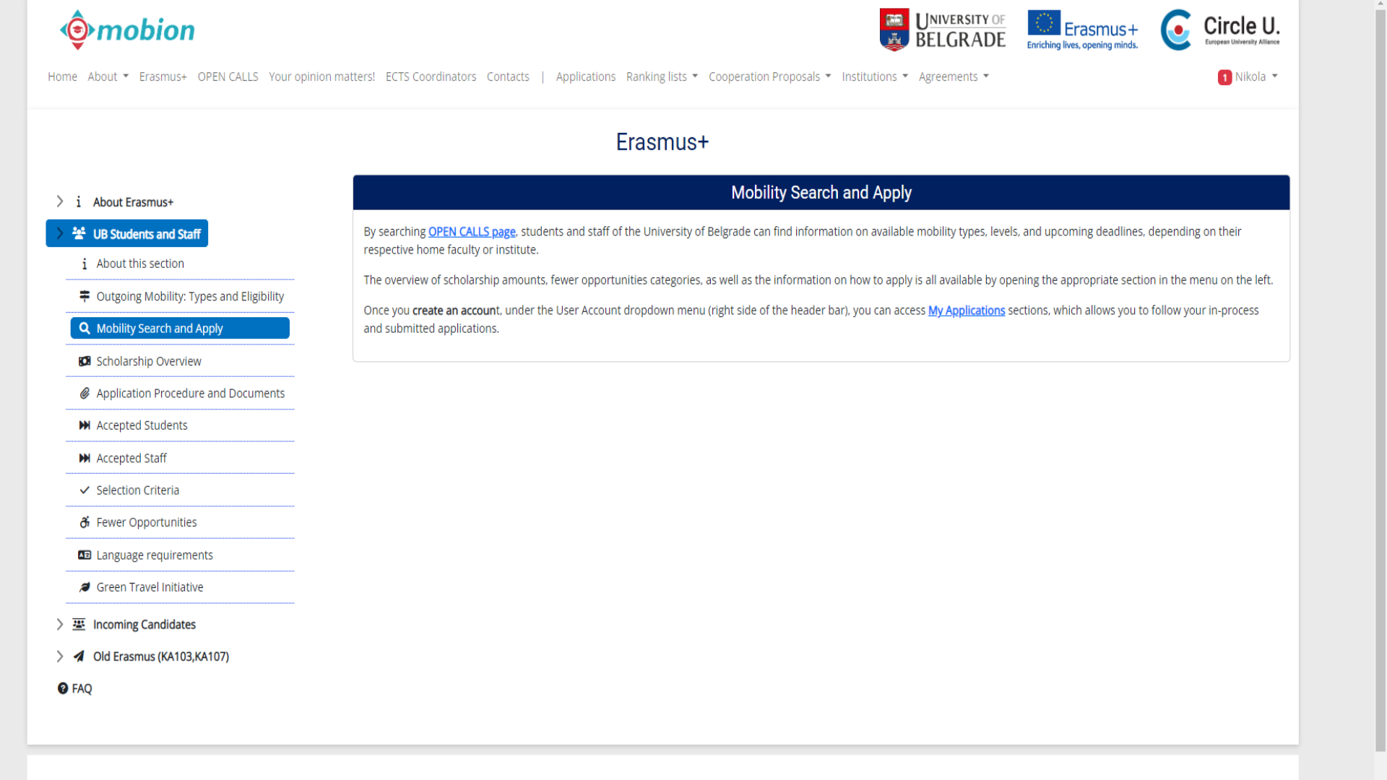

Slide 14
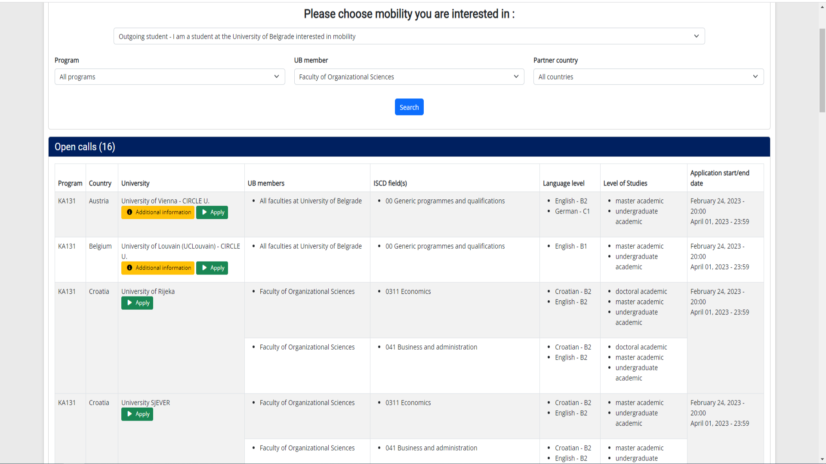

Slide 15
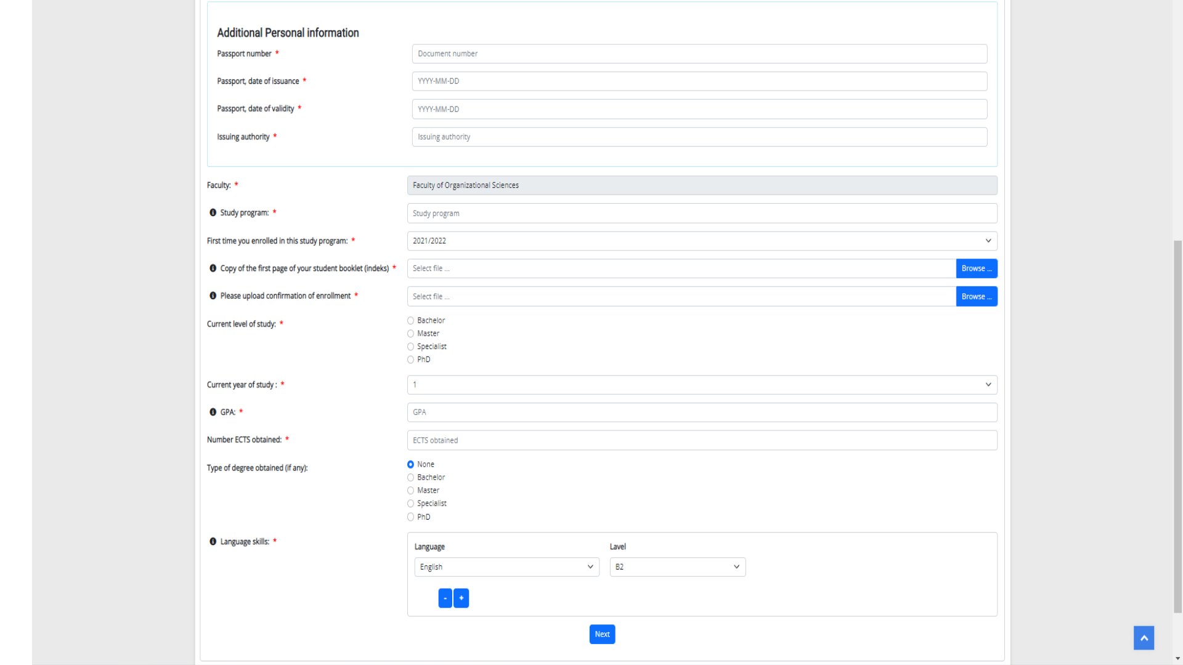

Slide 16
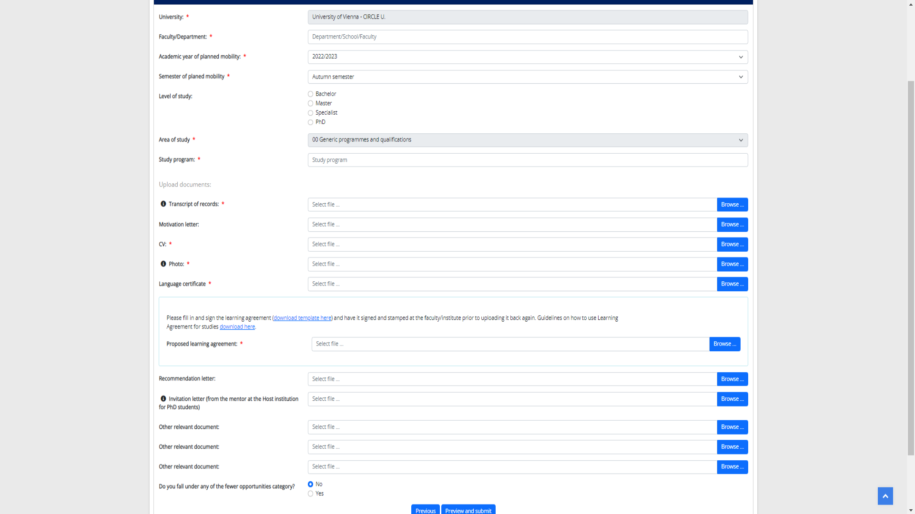

Slide 17

Хвала на пажњи! Питања?
Универзитет у Београду
Студентски трг 1
https://mobion.bg.ac.rs/contact
www.bg.ac.rs

